Slide 1
Chapter Sixteen
Equilibrium
均衡

Slide 2
Structure
Market equilibrium
Quantity tax and equilibrium
Tax incidence （税收分担）
Deadweight loss （额外净损失）

Slide 3
Market Equilibrium
A market is in equilibrium when total quantity demanded by buyers equals total quantity supplied by sellers.
Also called “market is cleared”
Supply may not equal production

Slide 4
Market Equilibrium
Market
demand
Market
supply
p
q=S(p)
q=D(p)
D(p), S(p)

Slide 5
Market Equilibrium
Market
demand
Market
supply
p
q=S(p)
D(p*) = S(p*); the market
is in equilibrium.
p*
q=D(p)
q*
D(p), S(p)

Slide 6
Market Equilibrium
Market
demand
Market
supply
p
q=S(p)
D(p’) < S(p’); an excess
of quantity supplied over
quantity demanded.
p’
p*
q=D(p)
D(p’)
S(p’)
D(p), S(p)

Slide 7
Market Equilibrium
Market
demand
Market
supply
p
q=S(p)
D(p’) < S(p’); an excess
of quantity supplied over
quantity demanded.
p’
p*
q=D(p)
D(p’)
S(p’)
D(p), S(p)
Market price must fall towards p*.

Slide 8
Market Equilibrium
Market
demand
Market
supply
p
q=S(p)
D(p”) > S(p”); an excess
of quantity demanded
over quantity supplied.
p*
p”
q=D(p)
S(p”)
D(p”)
D(p), S(p)

Slide 9
Market Equilibrium
Market
demand
Market
supply
p
q=S(p)
D(p”) > S(p”); an excess
of quantity demanded
over quantity supplied.
p*
p”
q=D(p)
S(p”)
D(p”)
D(p), S(p)
Market price must rise towards p*.

Slide 10


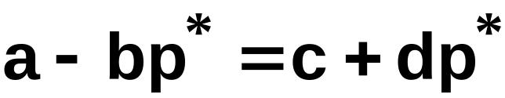
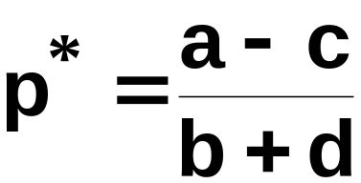
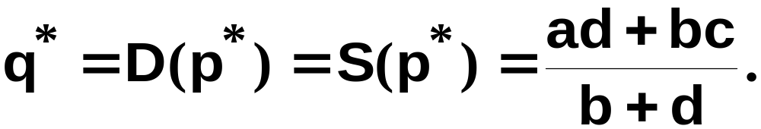
Market Equilibrium – Linear D & S
At the equilibrium price p*, D(p*) = S(p*).
That is,
which gives
and

Slide 11
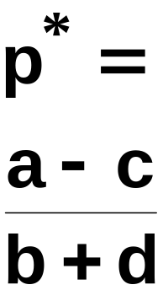
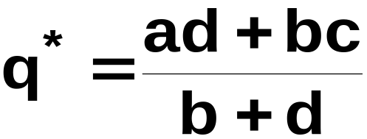
Market Equilibrium
Market
demand
Market
supply
p
S(p) = c+dp
D(p) = a-bp
D(p), S(p)

Slide 12
Market Equilibrium
Two special cases:
  quantity supplied is fixed, independent of the market price, and
  quantity supplied is extremely sensitive to the market price.

Slide 13
Market Equilibrium
Market quantity supplied is
fixed, independent of price.
p
S(p) = c+dp, so d=0
and S(p) ≡ c.
q* = c
q

Slide 14
Market Equilibrium
Market
demand
Market quantity supplied is
fixed, independent of price.
p
S(p) = c+dp, so d=0
and S(p) ≡ c.
p*
D⁻¹(q) = (a-q)/b
q* = c
q

Slide 15
Market Equilibrium
Market
demand
Market quantity supplied is
fixed, independent of price.
p
S(p) = c+dp, so d=0
and S(p) ≡ c.
p* =
(a-c)/b
p* = D⁻¹(q*); that is,
p* = (a-c)/b.
D⁻¹(q) = (a-q)/b
q* = c
q

Slide 16
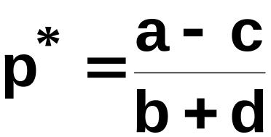
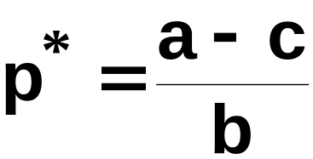
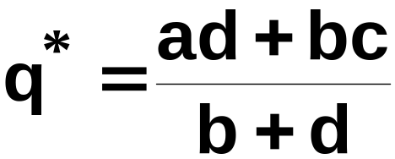
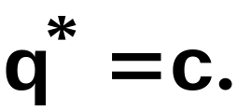
Market Equilibrium
Market
demand
Market quantity supplied is
fixed, independent of price.
p
S(p) = c+dp, so d=0
and S(p) ≡ c.
p* =
(a-c)/b
p* = D⁻¹(q*); that is,
p* = (a-c)/b.
D⁻¹(q) = (a-q)/b
q* = c
q
with d = 0 give

Slide 17
Market Equilibrium
Market quantity supplied is
extremely sensitive to price.
p
S⁻¹(q) = p*.
p*
q

Slide 18
Market Equilibrium
Market
demand
Market quantity supplied is
extremely sensitive to price.
p
S⁻¹(q) = p*.
p*
D⁻¹(q) = (a-q)/b
q*
q

Slide 19
Market Equilibrium
Market
demand
Market quantity supplied is
extremely sensitive to price.
p
S⁻¹(q) = p*.
p* = D⁻¹(q*) = (a-q*)/b so
q* = a-bp*
p*
D⁻¹(q) = (a-q)/b
q* =
a-bp*
q

Slide 20
Comparative Statics
Shifting demand curves
  Income
  Price of other products
Shifting supply curves
  Technology
Taxes

Slide 21
Quantity Taxes
A quantity tax levied at a rate of $t is a tax of $t paid on each unit traded.
If the tax is levied on sellers then it is an excise tax.
If the tax is levied on buyers then it is a sales tax.

Slide 22
Quantity Taxes
What is the effect of a quantity tax on a market’s equilibrium?
How are prices affected?
How is the quantity traded affected?
Who pays the tax?
How are gains-to-trade altered?

Slide 23
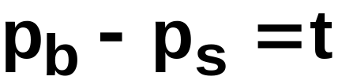
Quantity Taxes
A tax rate t makes the price paid by buyers, p_{b}, higher by t from the price received by sellers, p_{s}.

Slide 24
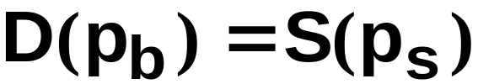
Quantity Taxes
Even with a tax the market must clear.
I.e. quantity demanded by buyers at price p_{b} must equal quantity supplied by sellers at price p_{s}.

Slide 25
Quantity Taxes
and
describe the market’s equilibrium.
Notice that these two conditions apply no
matter if the tax is levied on sellers or on
buyers.
Hence, a sales tax rate $t has the
same effect as an excise tax rate $t.

Slide 26
Quantity Taxes & Market Equilibrium
Market
demand
Market
supply
p
No tax
p*
q*
D(p), S(p)

Slide 27
Quantity Taxes & Market Equilibrium
Market
demand
Market
supply
p
An excise tax
raises the market
supply curve by $t
$t
p*
q*
D(p), S(p)

Slide 28
Quantity Taxes & Market Equilibrium
Market
demand
Market
supply
p
An excise tax
raises the market
supply curve by $t,
raises the buyers’
price and lowers the
quantity traded.
p_{b}
$t
p*
q^{t}
q*
D(p), S(p)

Slide 29
Quantity Taxes & Market Equilibrium
Market
demand
Market
supply
p
An excise tax
raises the market
supply curve by $t,
raises the buyers’
price and lowers the
quantity traded.
p_{b}
$t
p*
p_{s}
q^{t}
q*
D(p), S(p)
And sellers receive only p_{s} = p_{b} - t.

Slide 30
Quantity Taxes & Market Equilibrium
Market
demand
Market
supply
p
No tax
p*
q*
D(p), S(p)

Slide 31
Quantity Taxes & Market Equilibrium
Market
demand
Market
supply
p
An sales tax lowers
the market demand
curve by $t
p*
$t
q*
D(p), S(p)

Slide 32
Quantity Taxes & Market Equilibrium
Market
demand
Market
supply
p
An sales tax lowers
the market demand
curve by $t, lowers
the sellers’ price and
reduces the quantity
traded.
p*
p_{s}
$t
q^{t}
q*
D(p), S(p)

Slide 33
Quantity Taxes & Market Equilibrium
Market
demand
Market
supply
p
An sales tax lowers
the market demand
curve by $t, lowers
the sellers’ price and
reduces the quantity
traded.
p_{b}
p_{b}
p_{b}
p*
p_{s}
$t
q^{t}
q*
D(p), S(p)
And buyers pay p_{b} = p_{s} + t.

Slide 34
Quantity Taxes & Market Equilibrium
Market
demand
Market
supply
p
A sales tax levied at
rate $t has the same
effects on the
market’s equilibrium
as does an excise tax
levied at rate $t.
p_{b}
$t
p_{b}
p_{b}
p*
p_{s}
$t
q^{t}
q*
D(p), S(p)

Slide 35
Quantity Taxes & Market Equilibrium
Who pays the tax of $t per unit traded?
The division of the $t between buyers and sellers is the incidence of the tax (税收分担).

Slide 36
Quantity Taxes & Market Equilibrium
Market
demand
Market
supply
p
p_{b}
p_{b}
p_{b}
p*
p_{s}
q^{t}
q*
D(p), S(p)

Slide 37
Quantity Taxes & Market Equilibrium
Market
demand
Market
supply
p
Tax paid by
buyers
p_{b}
p_{b}
p_{b}
p*
p_{s}
q^{t}
q*
D(p), S(p)

Slide 38
Quantity Taxes & Market Equilibrium
Market
demand
Market
supply
p
p_{b}
p_{b}
p_{b}
p*
p_{s}
Tax paid by
sellers
q^{t}
q*
D(p), S(p)

Slide 39
Quantity Taxes & Market Equilibrium
Market
demand
Market
supply
p
Tax paid by
buyers
p_{b}
p_{b}
p_{b}
p*
p_{s}
Tax paid by
sellers
q^{t}
q*
D(p), S(p)

Slide 40


Quantity Taxes & Market Equilibrium
E.g. suppose the market demand and supply curves are linear.

Slide 41

Quantity Taxes & Market Equilibrium
and

Slide 42



Quantity Taxes & Market Equilibrium
and
With the tax, the market equilibrium satisfies
and
so
and

Slide 43
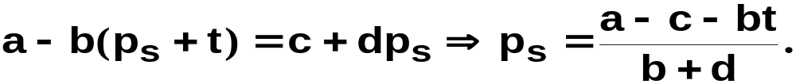
Quantity Taxes & Market Equilibrium
and
With the tax, the market equilibrium satisfies
and
so
and
Substituting for p_{b} gives

Slide 44
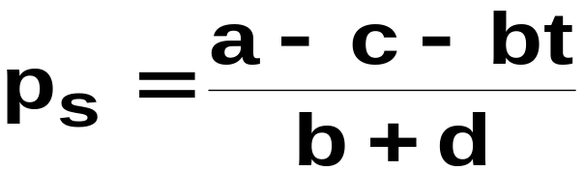

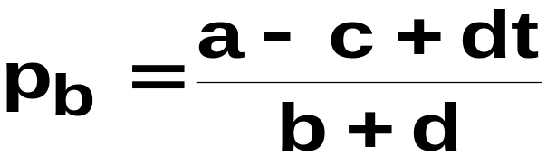
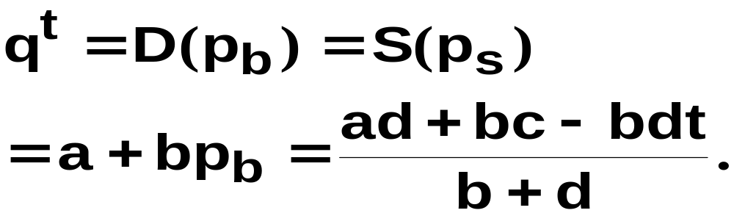
Quantity Taxes & Market Equilibrium
and
give
The quantity traded at equilibrium is

Slide 45
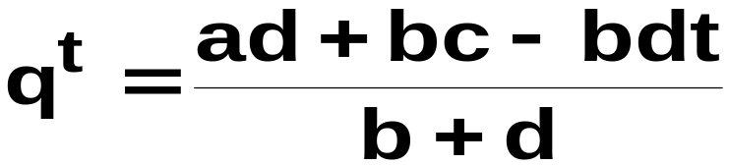
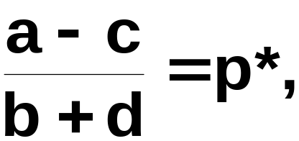
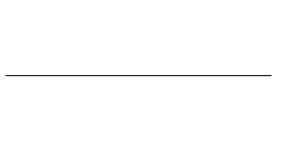
Quantity Taxes & Market Equilibrium
the
equilibrium price if
there is no tax (t = 0) and q^{t}
the quantity traded at equilibrium
when there is no tax.
As t → 0, p_{s} and p_{b} →
→

Slide 46
Quantity Taxes & Market Equilibrium
As t increases, p_{s} falls,
p_{b} rises,
and q^{t} falls.

Slide 47
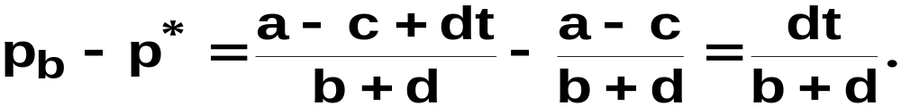
Quantity Taxes & Market Equilibrium
The tax paid per unit by the buyer is

Slide 48
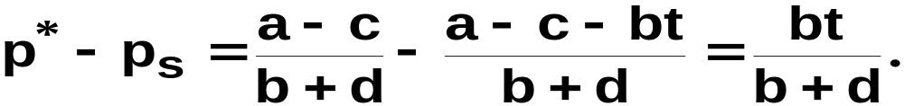
Quantity Taxes & Market Equilibrium
The tax paid per unit by the buyer is
The tax paid per unit by the seller is

Slide 49
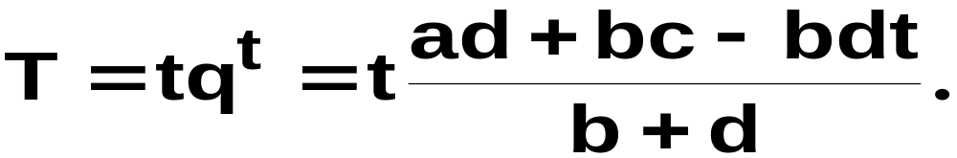
Quantity Taxes & Market Equilibrium
The total tax paid (by buyers and sellers
combined) is

Slide 50
Tax Incidence and Own-Price Elasticities
The incidence of a quantity tax depends upon the own-price elasticities of demand and supply.

Slide 51
Tax Incidence and Own-Price Elasticities
Market
demand
Market
supply
p
p_{b}
$t
p*
p_{s}
q^{t}
q*
D(p), S(p)

Slide 52
Tax Incidence and Own-Price Elasticities
Market
demand
Market
supply
p
Change to buyers’
price is p_{b} - p*.
Change to quantity
demanded is Δq.
p_{b}
$t
p*
p_{s}
q^{t}
q*
D(p), S(p)
Δq

Slide 53
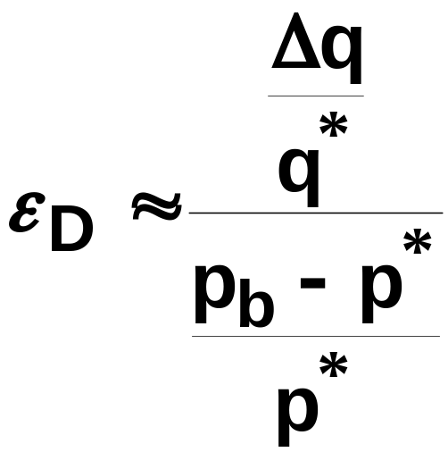
Tax Incidence and Own-Price Elasticities
Around p = p* the own-price elasticity
of demand is approximately

Slide 54
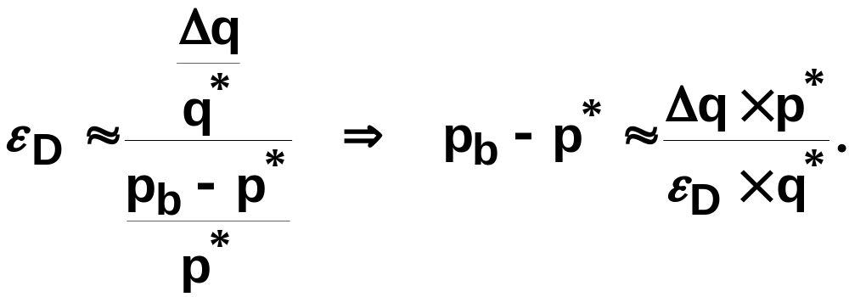
Tax Incidence and Own-Price Elasticities
Around p = p* the own-price elasticity
of demand is approximately

Slide 55
Tax Incidence and Own-Price Elasticities
Market
demand
Market
supply
p
p_{b}
$t
p*
p_{s}
q^{t}
q*
D(p), S(p)

Slide 56
Tax Incidence and Own-Price Elasticities
Market
demand
Market
supply
p
Change to sellers’
price is p_{s} - p*.
Change to quantity
demanded is Δq.
p_{b}
$t
p*
p_{s}
q^{t}
q*
D(p), S(p)
Δq

Slide 57
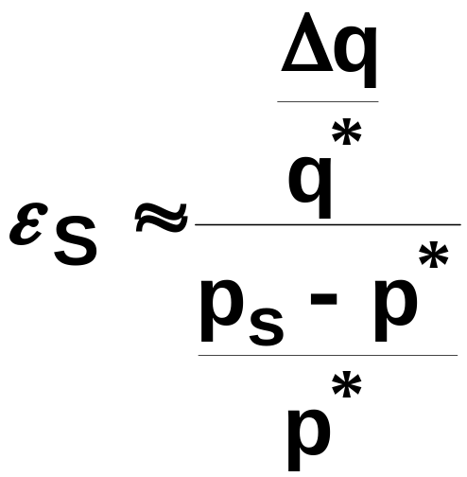
Tax Incidence and Own-Price Elasticities
Around p = p* the own-price elasticity
of supply is approximately

Slide 58
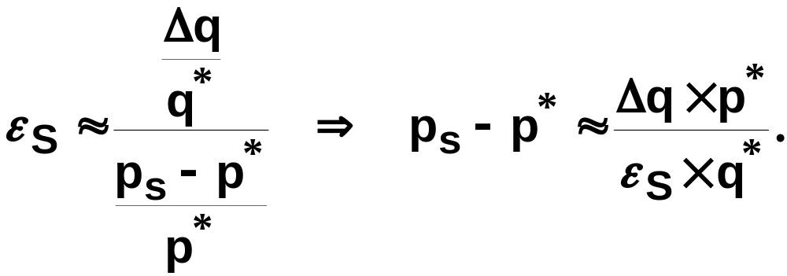
Tax Incidence and Own-Price Elasticities
Around p = p* the own-price elasticity
of supply is approximately

Slide 59
Tax Incidence and Own-Price Elasticities
Market
demand
Market
supply
p
Tax paid by
buyers
p_{b}
p_{b}
p_{b}
p*
p_{s}
Tax paid by
sellers
q^{t}
q*
D(p), S(p)

Slide 60
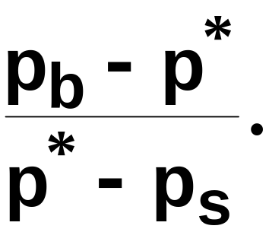
Tax Incidence and Own-Price Elasticities
Market
demand
Market
supply
p
Tax paid by
buyers
p_{b}
p_{b}
p_{b}
p*
p_{s}
Tax paid by
sellers
q^{t}
q*
D(p), S(p)
Tax incidence =

Slide 61
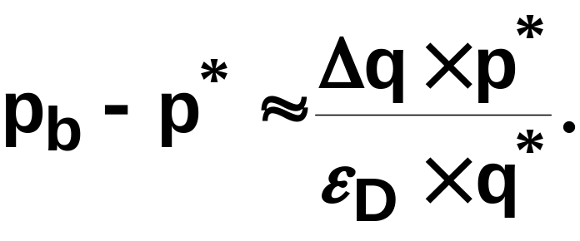
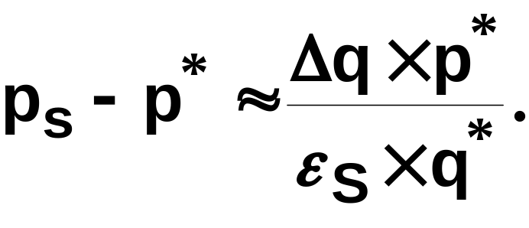
Tax Incidence and Own-Price Elasticities
Tax incidence =

Slide 62
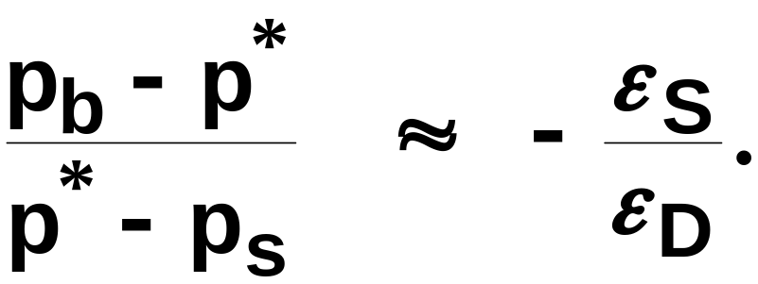
Tax Incidence and Own-Price Elasticities
Tax incidence =
So

Slide 63
Tax Incidence and Own-Price Elasticities
Tax incidence is
The fraction of a $t quantity tax paid
by buyers rises as supply becomes more
own-price elastic or as demand becomes
less own-price elastic.

Slide 64
Tax Incidence and Own-Price Elasticities
Market
demand
Market
supply
p
As market demand
becomes less own-
price elastic, tax
incidence shifts more
to the buyers.
p_{b}
$t
p*
p_{s}
q^{t}
q*
D(p), S(p)

Slide 65
Tax Incidence and Own-Price Elasticities
Market
demand
Market
supply
p
As market demand
becomes less own-
price elastic, tax
incidence shifts more
to the buyers.
p_{b}
$t
p*
p_{s}
q^{t}
q*
D(p), S(p)

Slide 66
Tax Incidence and Own-Price Elasticities
Market
demand
Market
supply
p
As market demand
becomes less own-
price elastic, tax
incidence shifts more
to the buyers.
p_{b}
$t
p_{s}= p*
q^{t} = q*
D(p), S(p)

Slide 67
Tax Incidence and Own-Price Elasticities
Market
demand
Market
supply
p
As market demand
becomes less own-
price elastic, tax
incidence shifts more
to the buyers.
p_{b}
$t
p_{s}= p*
q^{t} = q*
D(p), S(p)
When ε_{D} = 0, buyers pay the entire tax, even though it is levied on the sellers.

Slide 68
Tax Incidence and Own-Price Elasticities
Tax incidence is
Similarly, the fraction of a $t quantity
tax paid by sellers rises as supply
becomes less own-price elastic or as
demand becomes more own-price elastic.

Slide 69
Deadweight Loss and Own-Price Elasticities
A quantity tax imposed on a competitive market reduces the quantity traded and so reduces gains-to-trade (i.e. the sum of Consumers’ and Producers’ Surpluses).
The lost total surplus is the tax’s deadweight loss（额外净损失）, or excess burden.

Slide 70
Deadweight Loss and Own-Price Elasticities
Market
demand
Market
supply
p
No tax
p*
q*
D(p), S(p)

Slide 71
Deadweight Loss and Own-Price Elasticities
Market
demand
Market
supply
p
No tax
CS
p*
q*
D(p), S(p)

Slide 72
Deadweight Loss and Own-Price Elasticities
Market
demand
Market
supply
p
No tax
p*
PS
q*
D(p), S(p)

Slide 73
Deadweight Loss and Own-Price Elasticities
Market
demand
Market
supply
p
No tax
CS
p*
PS
q*
D(p), S(p)

Slide 74
Deadweight Loss and Own-Price Elasticities
Market
demand
Market
supply
p
The tax reduces
both CS and PS
p_{b}
CS
$t
p*
p_{s}
PS
q^{t}
q*
D(p), S(p)

Slide 75
Deadweight Loss and Own-Price Elasticities
Market
demand
Market
supply
p
The tax reduces
both CS and PS,
transfers surplus
to government
p_{b}
CS
$t
p*
Tax
p_{s}
PS
q^{t}
q*
D(p), S(p)

Slide 76
Deadweight Loss and Own-Price Elasticities
Market
demand
Market
supply
p
The tax reduces
both CS and PS,
transfers surplus
to government
p_{b}
CS
$t
p*
Tax
p_{s}
PS
q^{t}
q*
D(p), S(p)

Slide 77
Deadweight Loss and Own-Price Elasticities
Market
demand
Market
supply
p
The tax reduces
both CS and PS,
transfers surplus
to government
p_{b}
CS
$t
p*
Tax
p_{s}
PS
q^{t}
q*
D(p), S(p)

Slide 78
Deadweight Loss and Own-Price Elasticities
Market
demand
Market
supply
p
The tax reduces
both CS and PS,
transfers surplus
to government,
and lowers total
surplus.
p_{b}
CS
$t
p*
Tax
p_{s}
PS
q^{t}
q*
D(p), S(p)

Slide 79
Deadweight Loss and Own-Price Elasticities
Market
demand
Market
supply
p
p_{b}
$t
p*
p_{s}
Deadweight loss
q^{t}
q*
D(p), S(p)

Slide 80
Deadweight Loss and Own-Price Elasticities
Market
demand
Market
supply
p
Deadweight loss falls
as market demand
becomes less own-
price elastic.
p_{b}
$t
p*
p_{s}
q^{t}
q*
D(p), S(p)

Slide 81
Deadweight Loss and Own-Price Elasticities
Market
demand
Market
supply
p
Deadweight loss falls
as market demand
becomes less own-
price elastic.
p_{b}
$t
p_{s}= p*
q^{t} = q*
D(p), S(p)
When ε_{D} = 0, the tax causes no deadweight loss.

Slide 82
Deadweight Loss and Own-Price Elasticities
Deadweight loss due to a quantity tax rises as either market demand or market supply becomes more own-price elastic.
If either ε_{D} = 0 or ε_{S} = 0 then the deadweight loss is zero.

Slide 83
Examples of Equilibrium Analysis
Price ceiling
Minimum price
  Agricultural price control
  Minimum wage

Slide 84
Price control
p
ΔCS=C-E
ΔPS=-C-F
DWL=-E-F
+waiting in line
A
B
E
p*
F
C
p_{max}
D
q_{S}
q*
q_{D}
D(p), S(p)

Slide 85
Price control with rationing
p
ΔCS=C-E
ΔPS=-C-F
DWL=-E-F
+corruption
A
B
E
p*
F
C
p_{max}
D
q_{max}
q*
D(p), S(p)

